Slide 1
Project 3
Rekha Kondeti
Graduate

Slide 2
Task-1
Support Vector Machines for breast cancer
Using RBF, linear and polynomial degree 2,3
confusion matrices for training and testing datasets

Slide 3
Methods Used
#Splitting data to training and testing:
x_train, x_test, y_train, y_test = train_test_split(p, T, test_size = 0.3,
random_state=10)
#feature scaling for LDA:
from sklearn.preprocessing import StandardScaler
sc = StandardScaler()
x_train = sc.fit_transform(x_train)
x_test = sc.transform(x_test)
print(x_train)
print(x_train.shape)
#For rbf kernel:
from sklearn import svm, datasets
svc_classifier = svm.SVC(kernel='rbf', C=1.0).fit(x_train,y_train)
print(svc_classifier.predict(x_test))
print(svc_classifier.score(x_test,y_test))
#For Linear kernel:
svc_classifier = svm.SVC(kernel='linear’,C=1.0).fit(x_train,y_train)
print(svc_classifier.predict(x_test))
print(svc_classifier.score(x_test,y_test))
#For polynomial kernel:
svc_classifier = svm.SVC(kernel='poly’,C=1.0).fit(x_train,y_train)
print(svc_classifier.predict(x_test))
print(svc_classifier.score(x_test,y_test))
#ROC Curve:
from sklearn.metrics import plot_roc_curve
roc_lda = plot_roc_curve(model, x_train, y_train)
plt.show()
#Confusion Matrix:
from pretty_confusion_matrix import pp_matrix_from_data
pp_matrix_from_data(y_train, y_pred_train,cmap='PuRd')
plt.show()

Slide 4
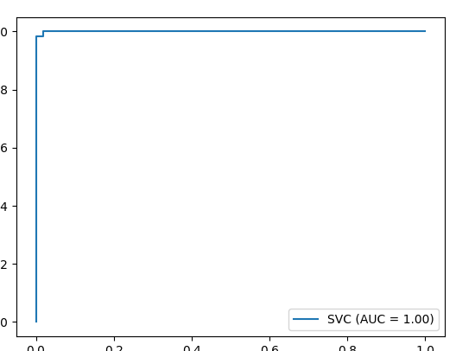
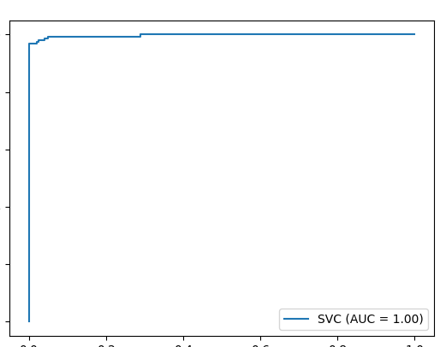
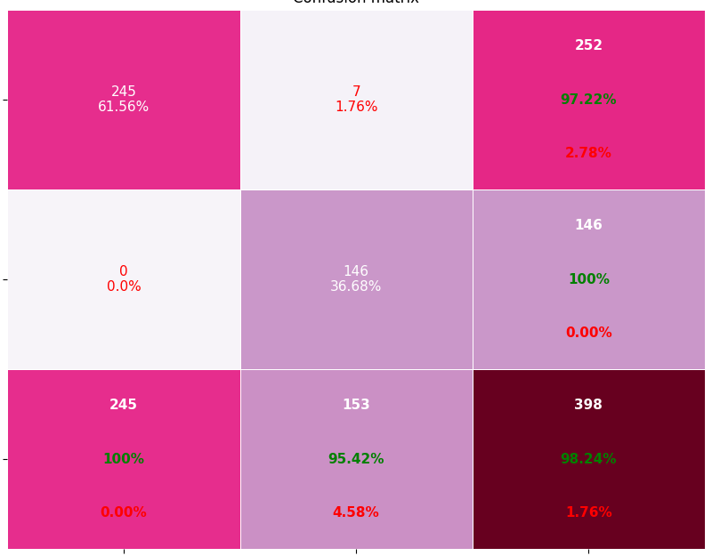
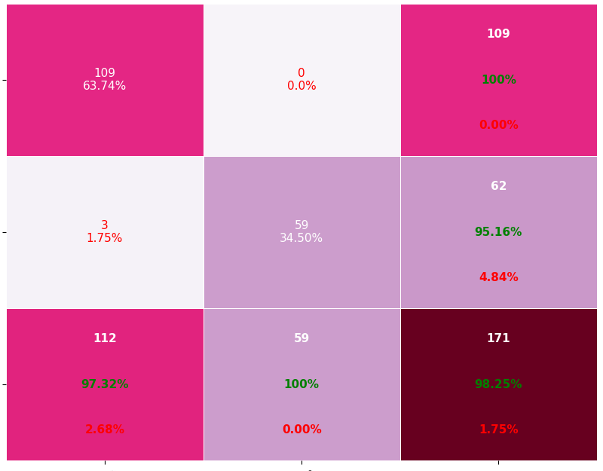
Roc and Classification matrix for #For rbf kernel: Roc and Classification matrix for #For rbf kernel: Roc and Classification matrix for #For rbf kernel: Roc and Classification matrix for Rbf kernel:
Training:
Testing:

Slide 5
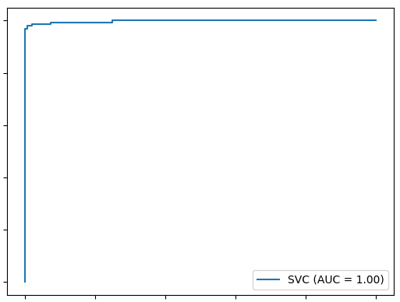
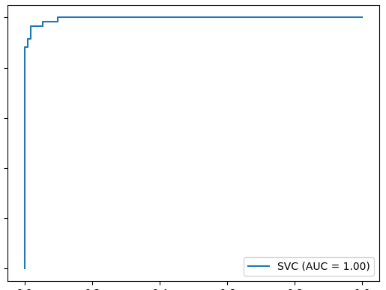
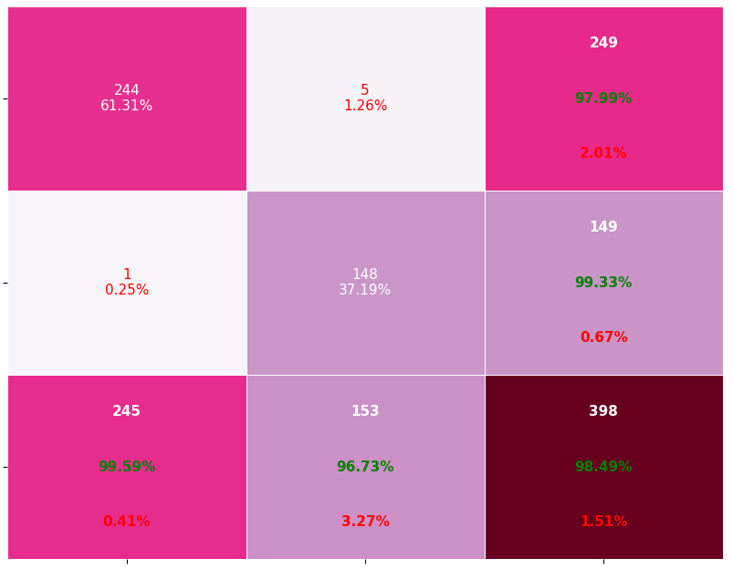
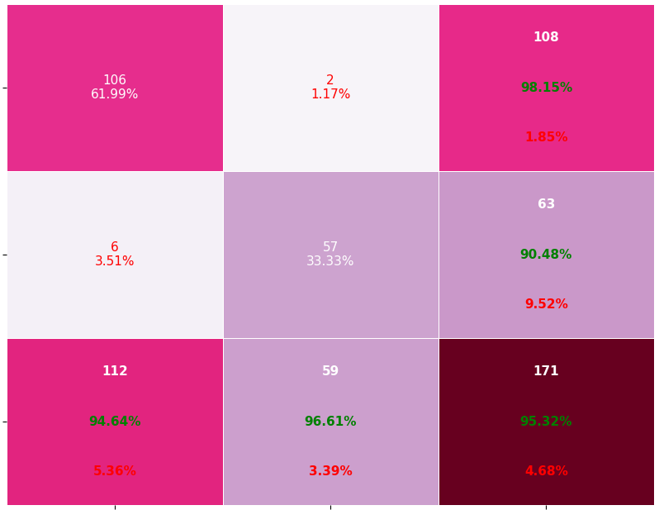
Roc and Classification matrix for #For rbf kernel: Roc and Classification matrix for #For rbf kernel: Roc and Classification matrix for #For rbf kernel: Roc and Classification matrix for Linear kernel
Training:
Testing:

Slide 6
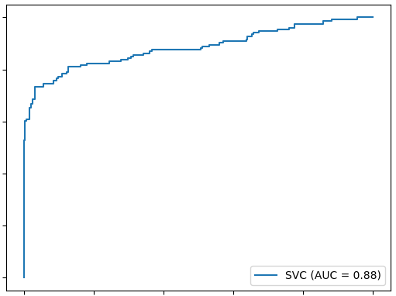
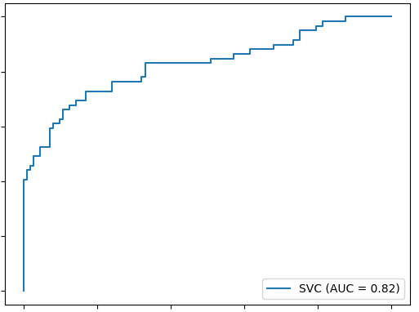
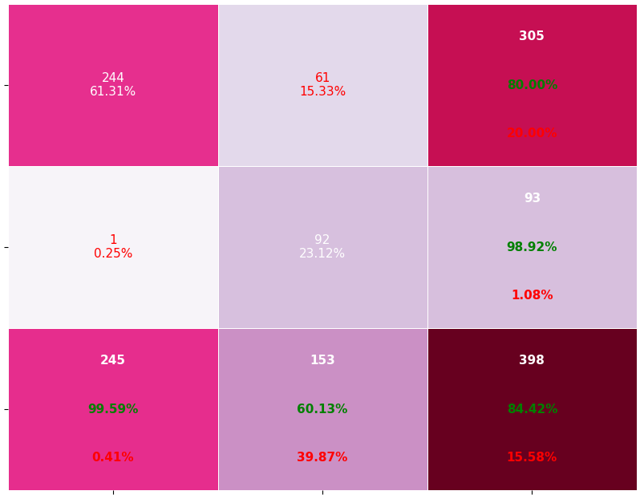
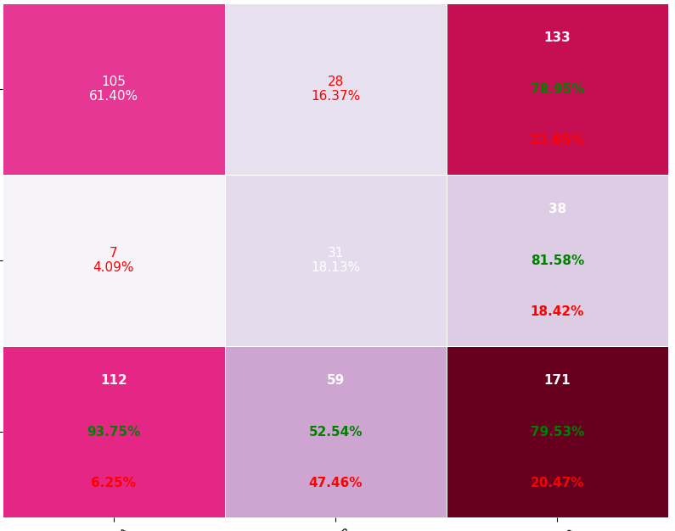
Roc and Classification matrix for #For rbf kernel: Roc and Classification matrix for #For rbf kernel: Roc and Classification matrix for #For rbf kernel: Roc and Classification matrix for polynomial kernel degree 2
Training:
Testing:

Slide 7
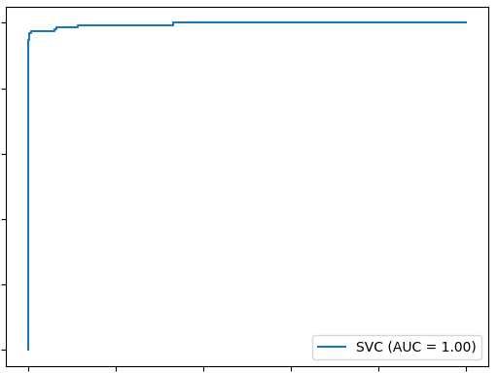
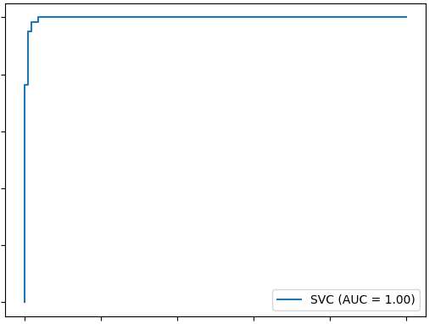
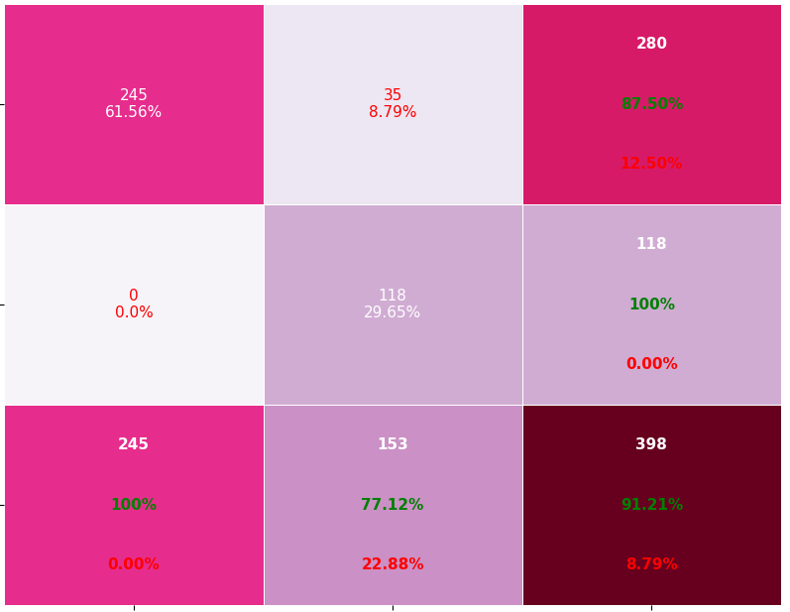
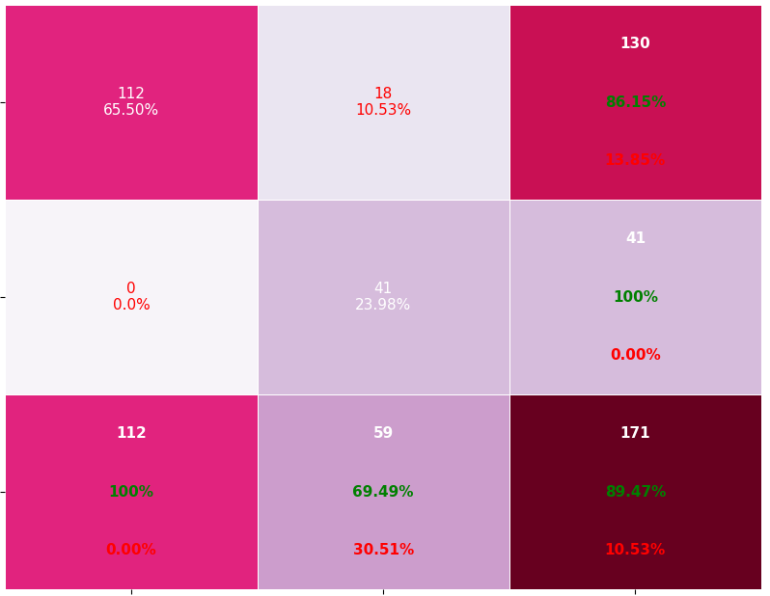
Roc and Classification matrix for #For rbf kernel: Roc and Classification matrix for #For rbf kernel: Roc and Classification matrix for #For rbf kernel: Roc and Classification matrix for polynomial kernel degree 3
Training:
Testing:

Slide 8
Observations of Task1
Among all the kernels, Gaussian kernel(rbf) performs better than all the other kernels. From the above classification matrices, we can see that the performance of Gaussian is 98% and all the remaining kernels has less .Hence it performs better .
However, there is no perfect rule as to which kernel performs best in every scenario. It is all about testing all the kernels and selecting the one with the best results on your test dataset.

Slide 9
Task-2
Changing c value (ie 3 different values) and Using RBF, linear and polynomial degree 2,3
confusion matrices for training and testing datasets

Slide 10
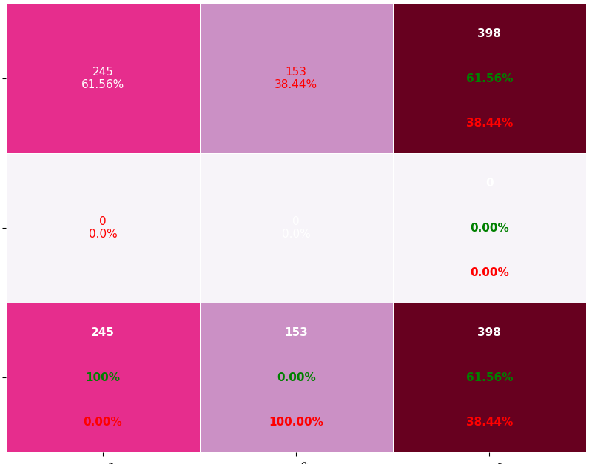
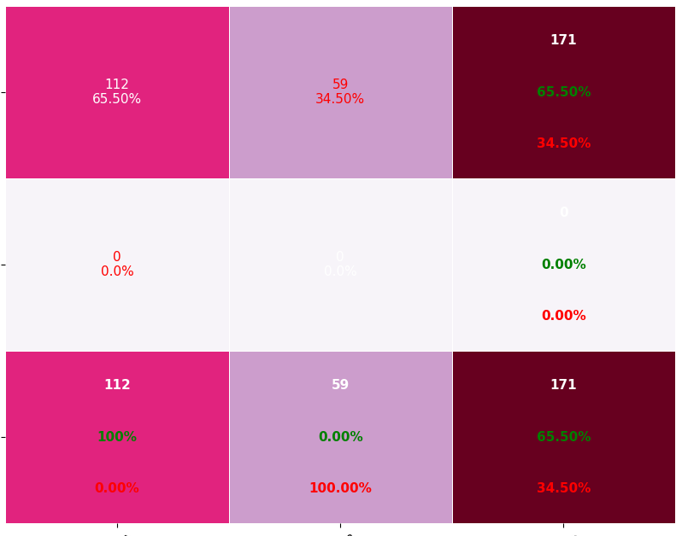
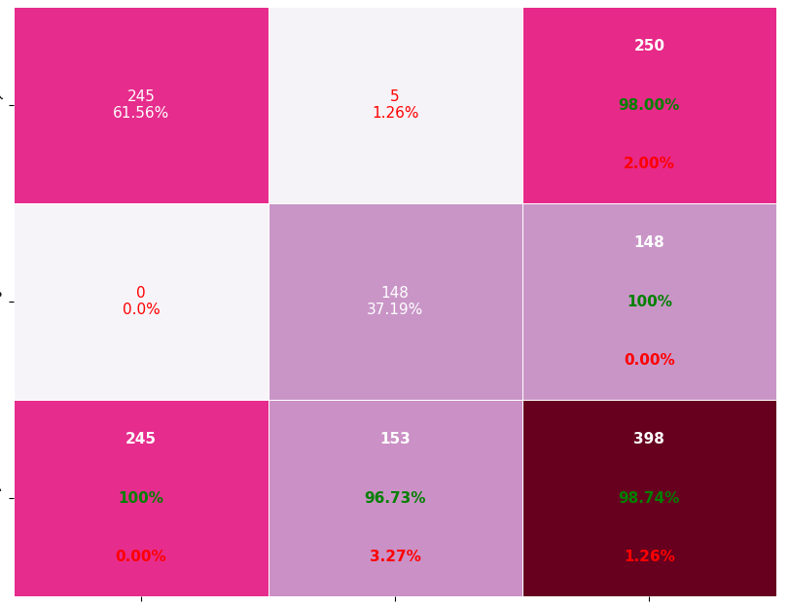
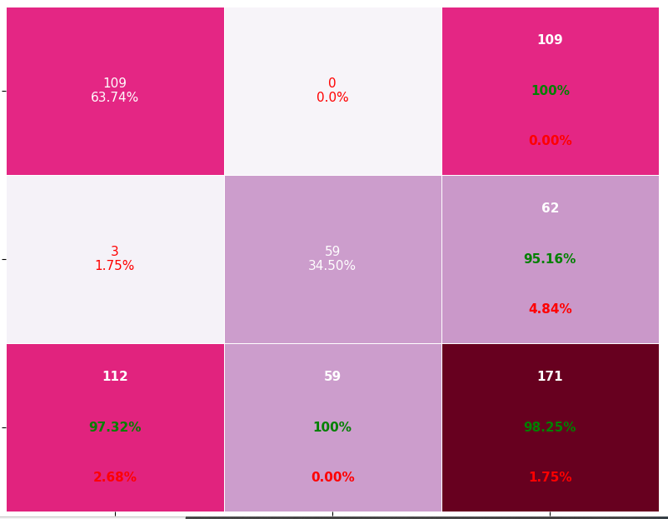
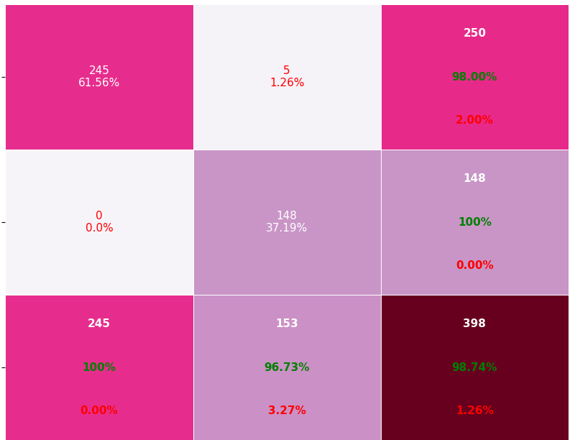

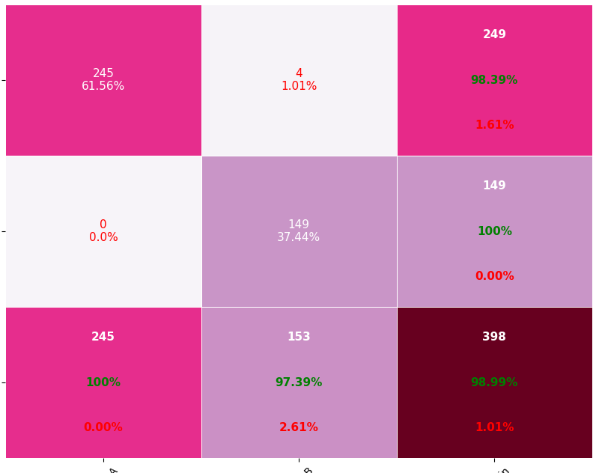
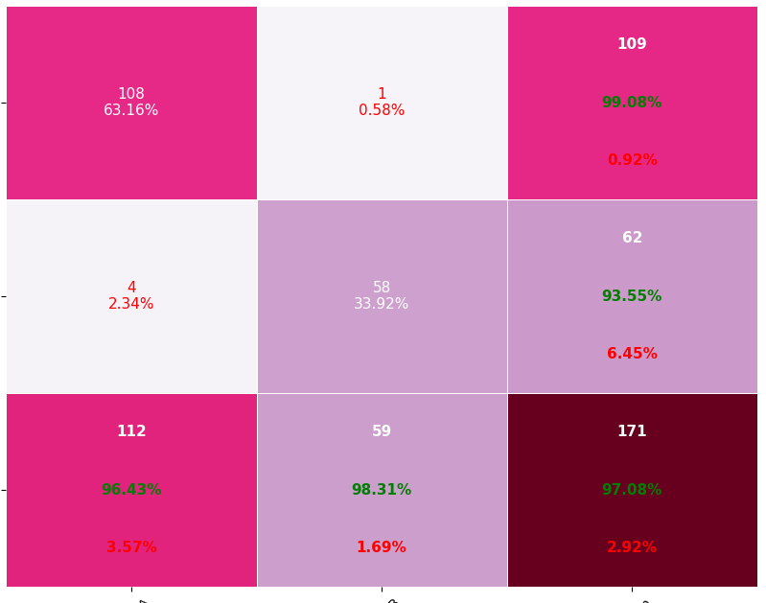
Roc and Classification matrix for #For rbf kernel: Roc and Classification matrix for #For rbf kernel: Roc and Classification matrix for #For rbf kernel: Classification matrix for Rbf kernel with varying C values
For c=0.01(underfitting)
Training Testing
For c=10(better)
Training Testing
For C= 0.01
Training TestingFor c=5
For c=15(overfitting)
For c=5(better)

Slide 11
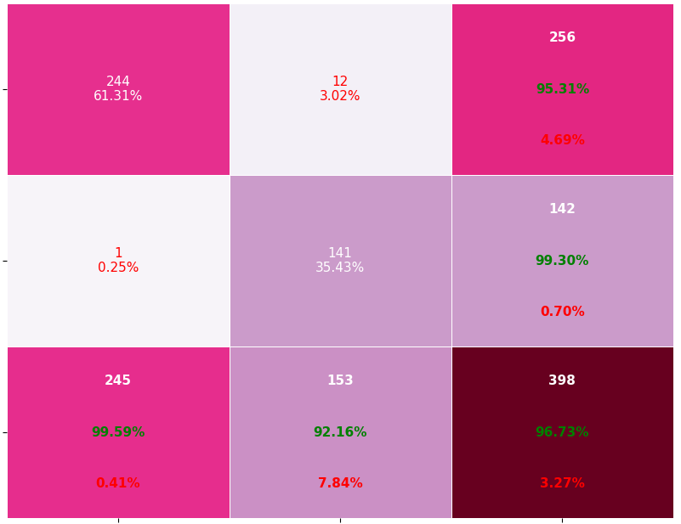
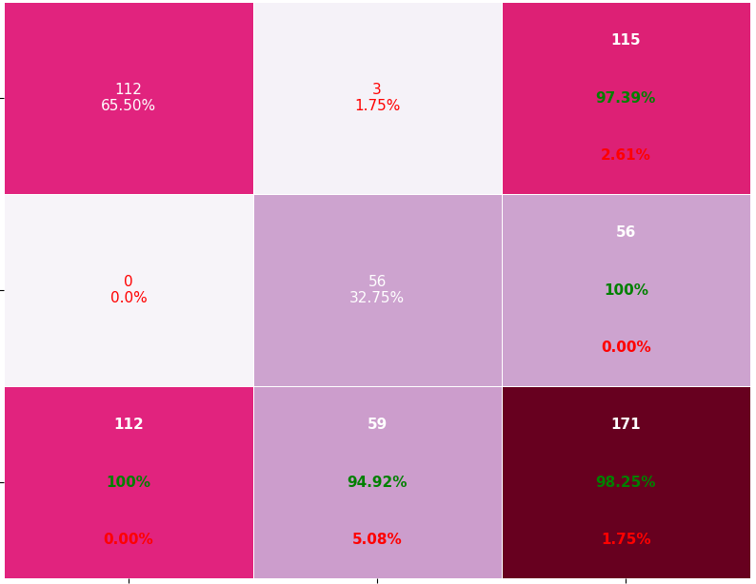
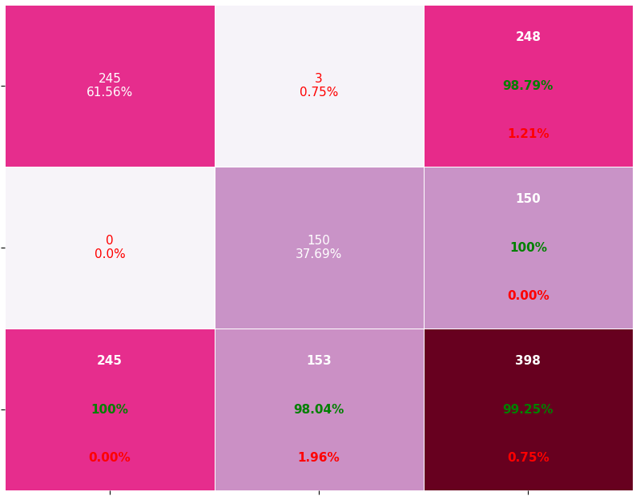
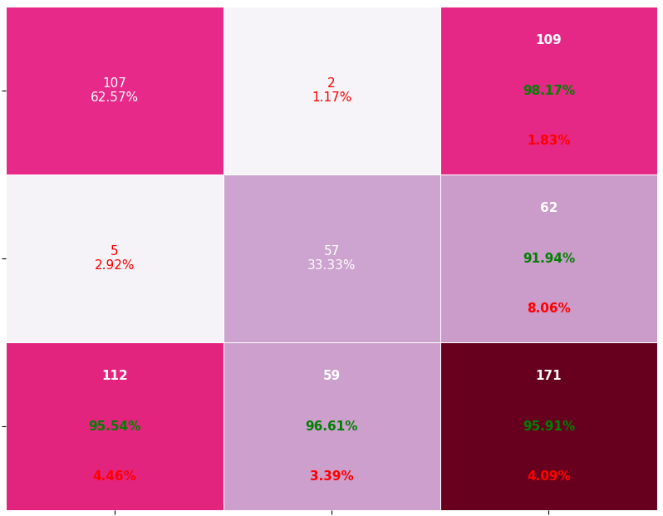
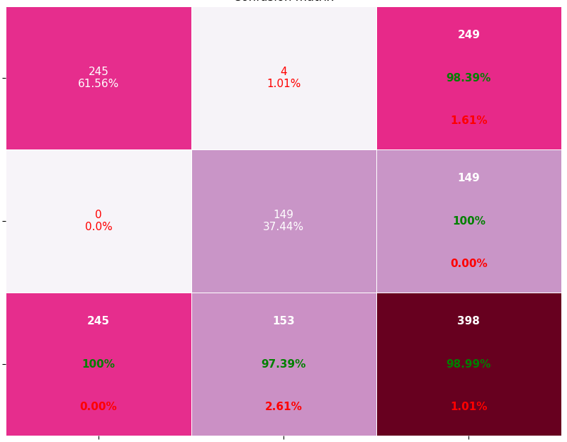
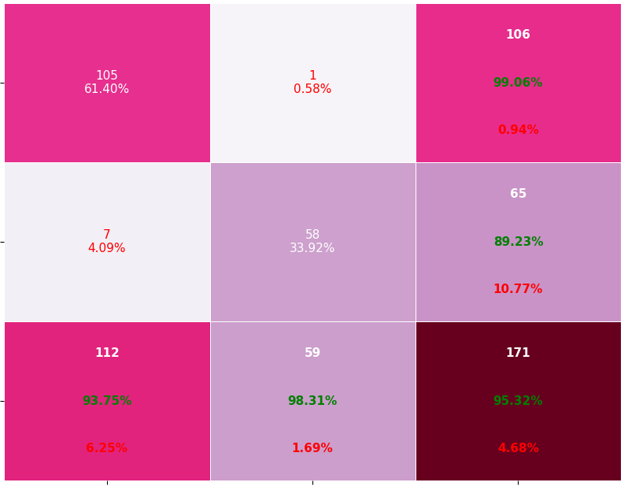
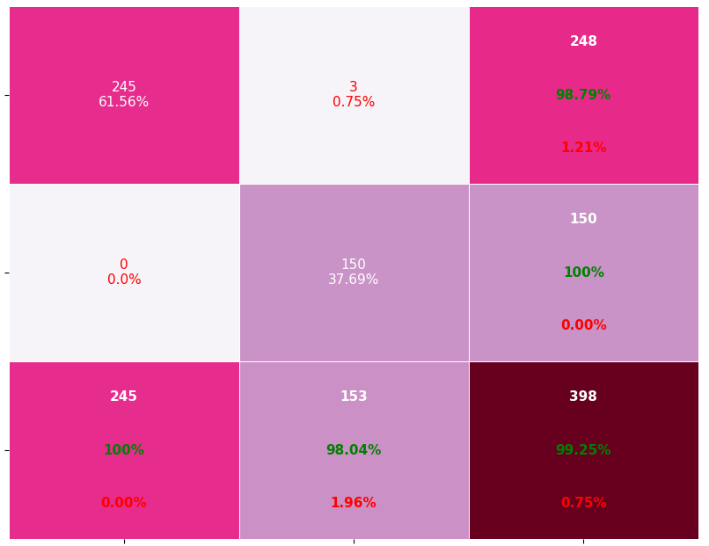
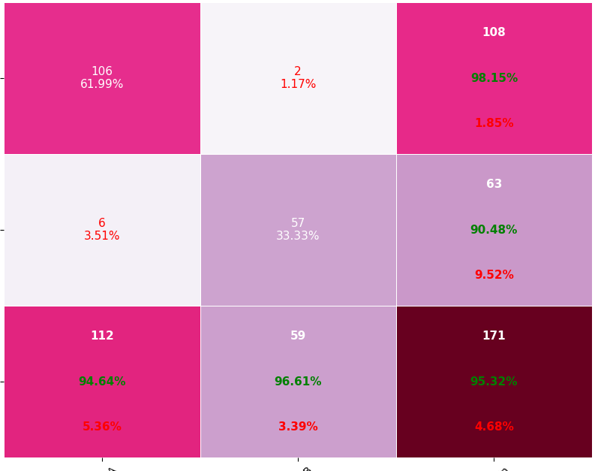
Roc and Classification matrix for #For rbf kernel: Roc and Classification matrix for #For rbf kernel: Roc and Classification matrix for #For rbf kernel: Classification matrix for Linear kernel with varying C values
For c=0.01(Better)
Training Testing
For c=10(better)
Training Testing
For c=15(Better)
For c=5(better)

Slide 12
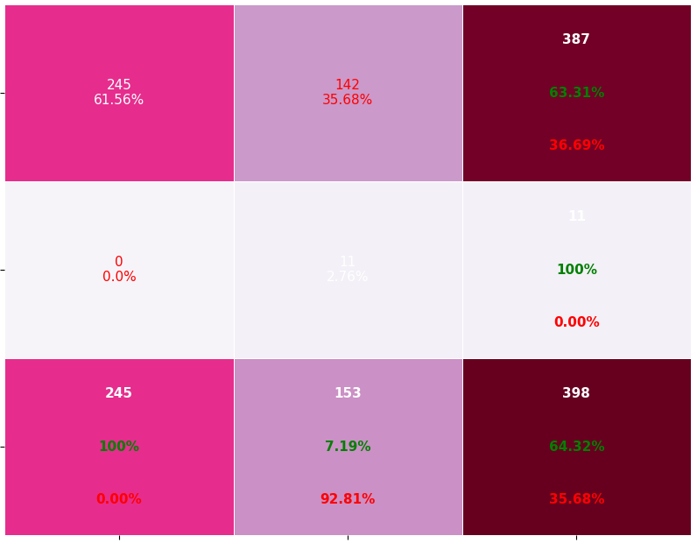
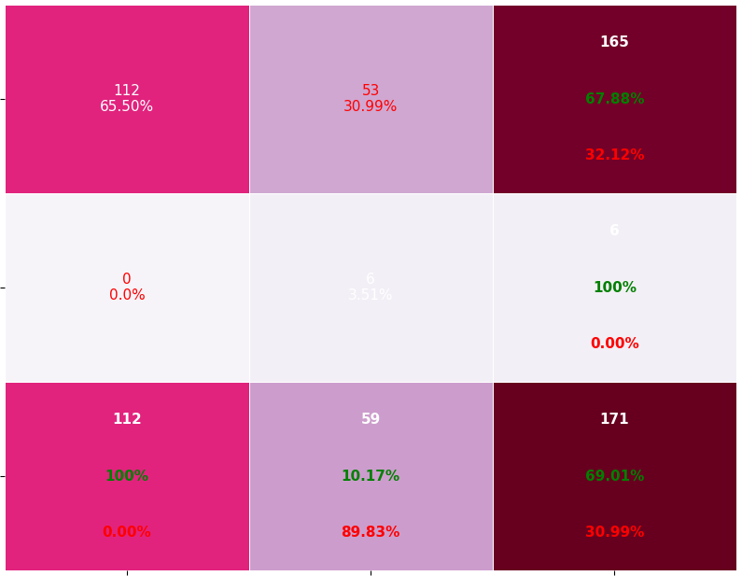
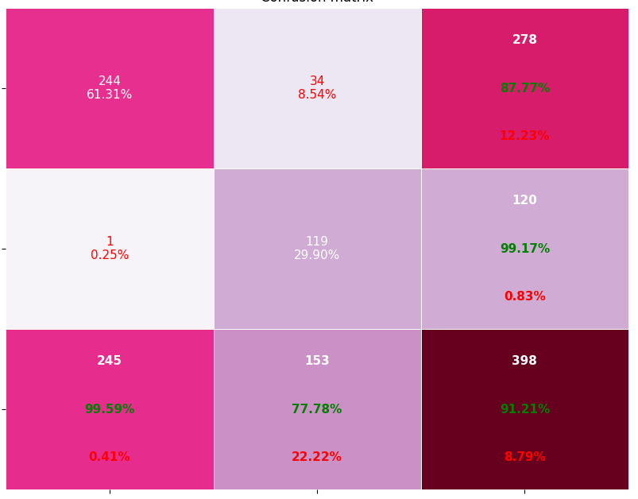
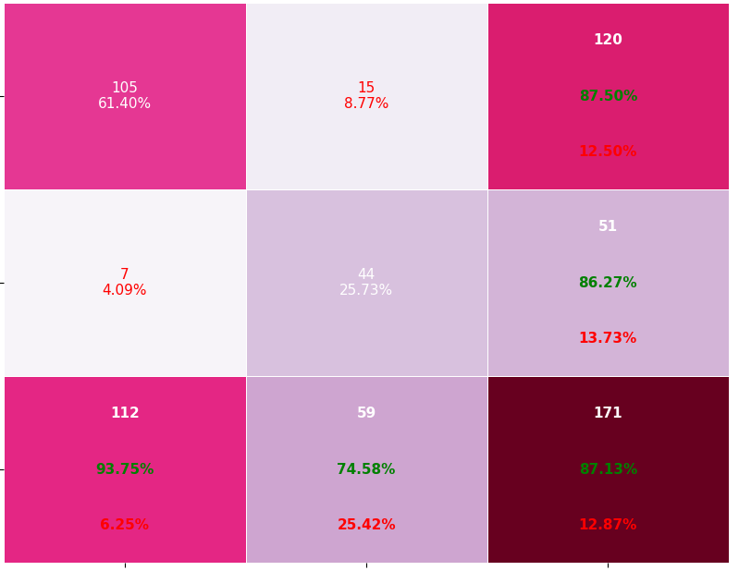
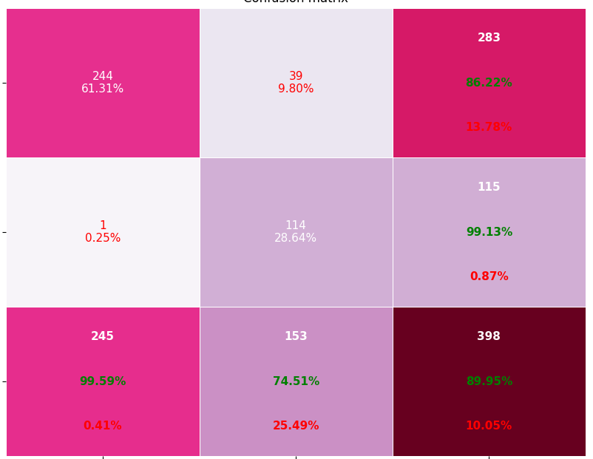
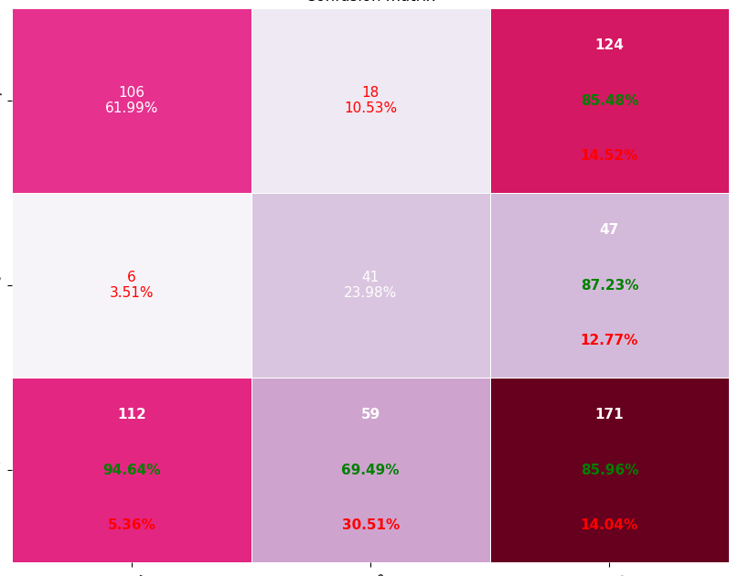
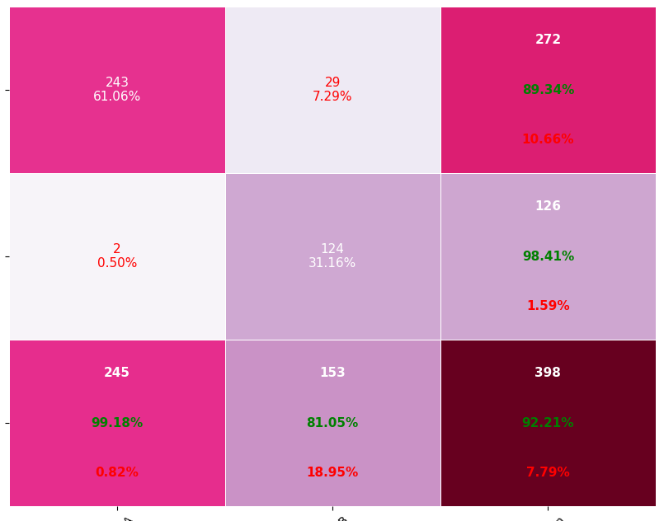
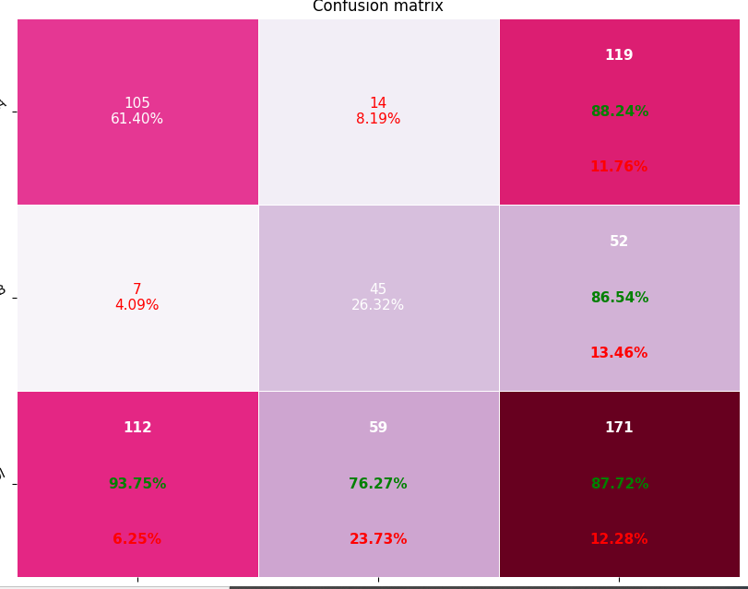
Roc and Classification matrix for #For rbf kernel: Roc and Classification matrix for #For rbf kernel: Roc and Classification matrix for #For rbf kernel: Classification matrix for Polynomial kernel degree 2 with varying C values
For c=0.01(underfitting)
Training Testing
For c=10(better compared to previous)
Training Testing
For c=15(better compared compared to previous)
For c=5(better compared to previous)

Slide 13
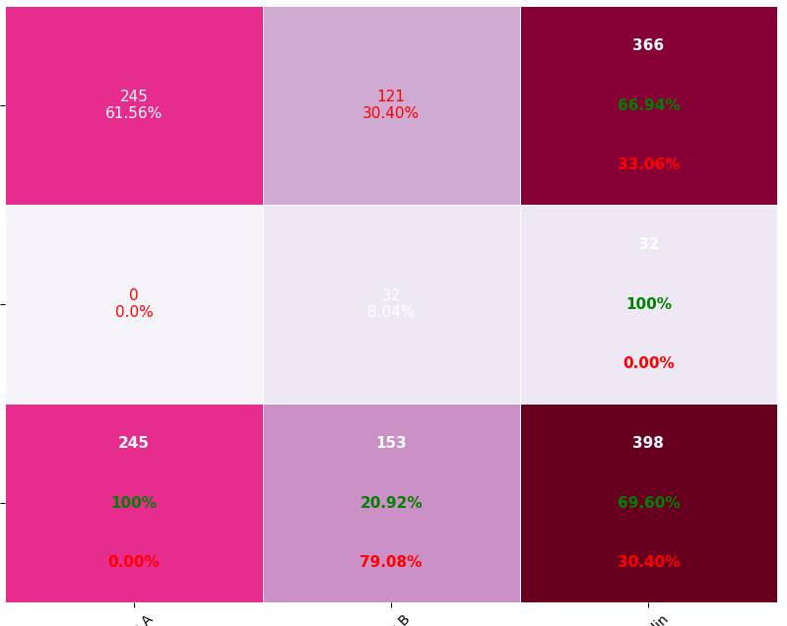
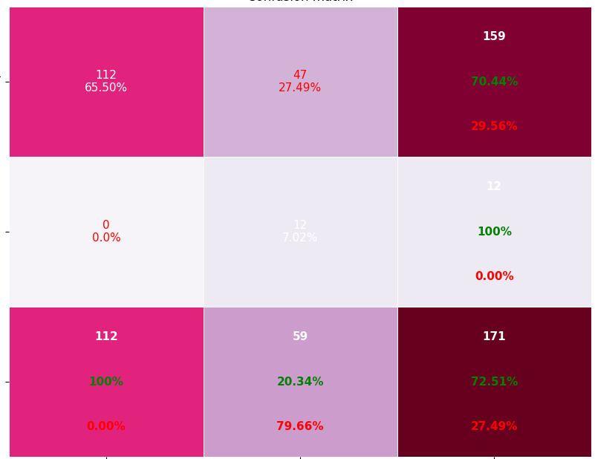
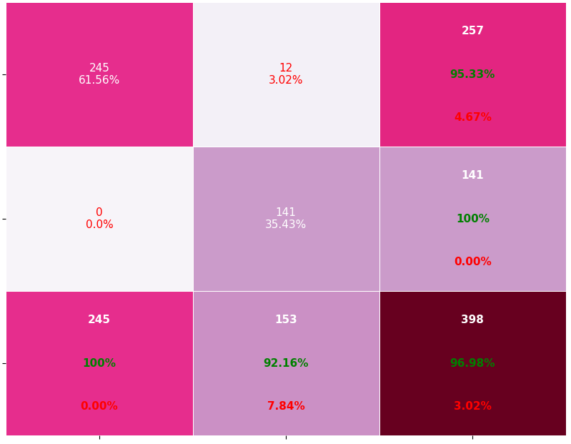
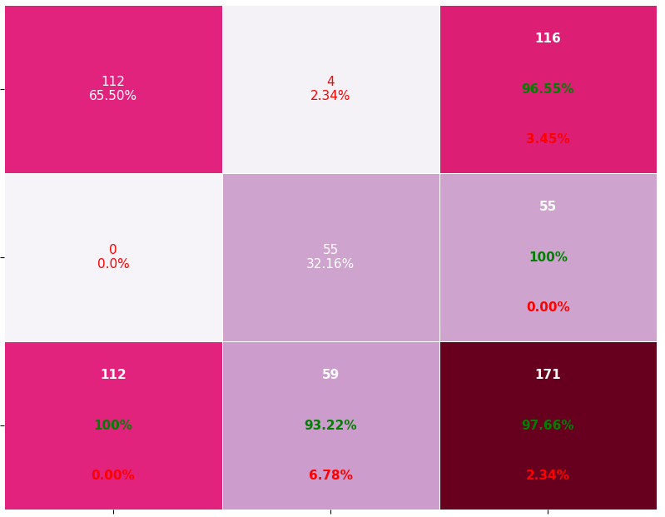
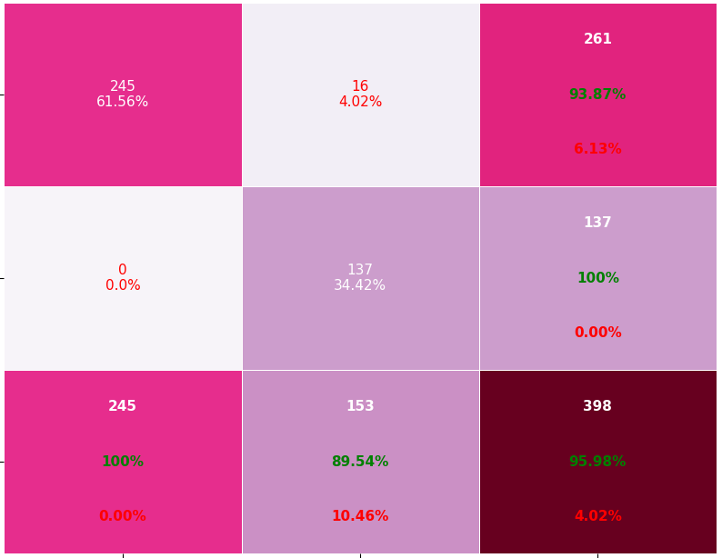
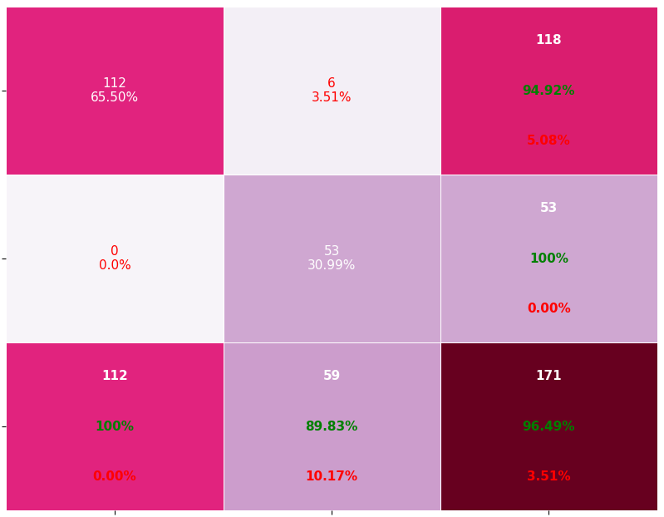
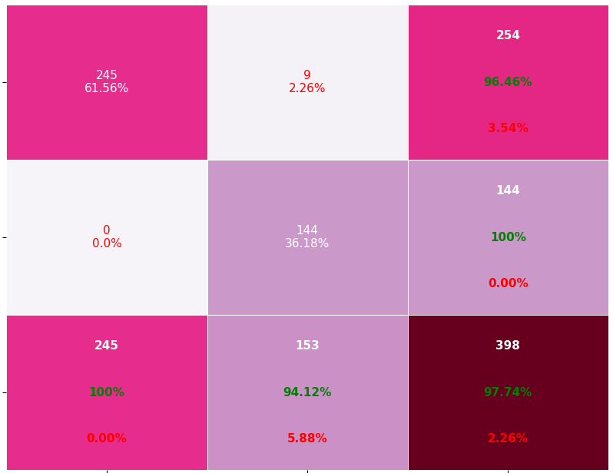
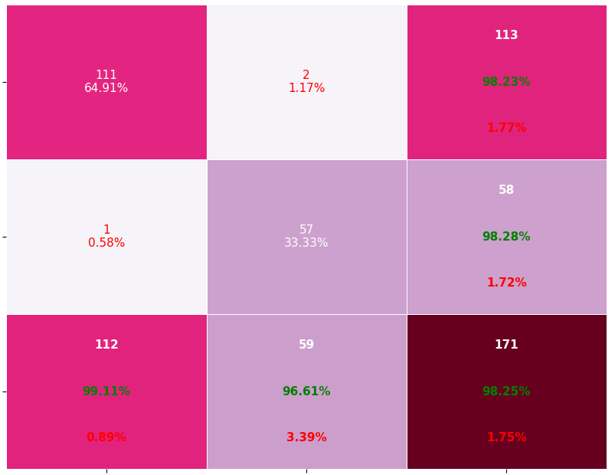
Roc and Classification matrix for #For rbf kernel: Roc and Classification matrix for #For rbf kernel: Roc and Classification matrix for #For rbf kernel: Classification matrix for Polynomial kernel degree 3 with varying C values
For c=0.01(underfitting)
Training Testing
For c=10(better)
Training Testing
For c=15(better)
For c=5(better )

Slide 14
Observations of Task2 and conclusion
Varying parameter C : C behaves as regularizing parameter in SVM
The parameter C gives the correct classification of training examples and gives decision
Large Value of parameter C => Small margin
Small Value of parameter C => Large margin
There is no rule to choose value for c. It depends on dataset. We need to check for which value it performs better and consider that c value.
From the above, we can observe that for low values of C we are getting underfitting and for high values of c we are getting overfitting. For the Values in between are showing better performance. For each kernel for different values of c performance is varied.
However, there is no perfect rule as to which kernel performs best in every scenario. It is all about testing all the kernels and selecting the one with the best results on your test dataset.
Value of c | RBF | Linear | Poly with degree 2 | Poly with degree 3
0.01 | Underfitting | Better | Underfitting | Underfitting
1 | Better | Better | Better | Better
5 | Better | Better | Better | Better
10 | Better | Better | Better | Better
15 | Overfitting | Better | Better | Better

